Slide 1
SharePoint Foundation Development
Fundamentals of the SharePoint Development Platform
Notes:
In this module we'll dive into the core development concepts in SharePoint Foundation 2010. Developers will get up to speed on the server-side object model and learn the basics of SharePoint features and solution packages. In addition students will be introduced to the SharePoint Developer Tools in Visual Studio 2010 and begin using SharePoint projects to create, test and debug business solutions.

Slide 2
Agenda
Getting Started
The Server-side Object Model
Features and Solutions
The SharePoint Developer Tools in Visual Studio

Slide 3
SharePoint 2010
A Development platform
Microsoft SharePoint Foundation (SPF) 2010 renamed from Windows SharePoint Services (WSS)
Microsoft SharePoint Server (SPS) 2010
Browser Clients
Microsoft SharePoint Server 2010
MS Word Clients
Microsoft SharePoint Foundation 2010
MS Outlook Clients
.NET Framework and ASP.NET 3.5 SP1
Internet Information Services 7.0
Windows Server 2008 (x64 only) for Production Environments
Windows 7 or Vista (x64 only) for Development Environments only
requires a 64-bit OS
built On .NET 3.5 SP1
development now supported on client OS
Notes:
SharePoint 2010 is an umbrella term for several different products in the SharePoint technology stack.
SharePoint Foundation 2010
SharePoint Server 2010 Standard
SharePoint Server 2010 Enterprise
SharePoint Server 2010 for Internet Sites, Standard
SharePoint Server 2010 for Internet Sites, Enterprise
SharePoint 2010 only runs on 64-bit operating systems. This is different from the previous version which ran on either a 32-bit OS and a 64-bit OS.
SharePoint 2010 is the first version of the platform that supports installation on a client OS for development. The supported clients OS’ included 64-bit version of Windows 7 and Windows Vista.

Slide 4
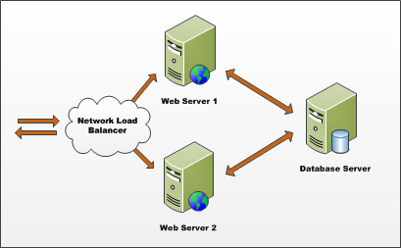
Farms
SharePoint deployment based on farms
Farm requires Web server(s) and database server
Farm can be single server or multi-server
Each farm has exactly one configuration database
Single-server farm used for development environments
Notes:
A SharePoint Farm is simply a collection of servers that have SharePoint installed on them and are all connected to the same configuration database (aka: the config DB).

Slide 5
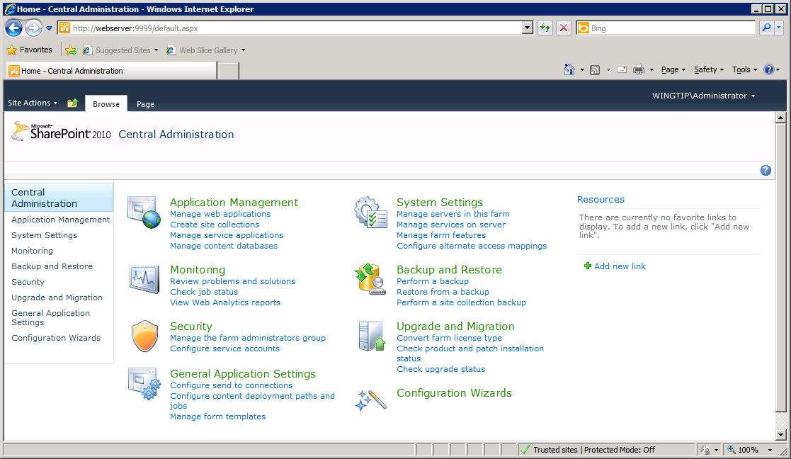
Central Administration
Site for Administrators to make farm wide settings
Home page has sections broken out by functionality
Each Central Administration site specific to one farm
Notes:
This is the home page of the SharePoint 2010 Central Administration. It contains links to different administration pages, divided in sections by functionality.
Each section title is also a link which brings you to another page containing links again divided in sections by functionality.
You also find the section titles in the Quick Launch on the left of the page.

Slide 6
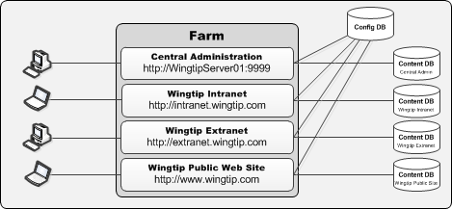
Web Applications
Web Applications provide HTTP entry points
Web Applications based on IIS Web sites
Web Application defines one or more URL spaces
Web Application security configured independently
Notes:
SharePoint sites and content live within SQL Server databases called “content databases”. SharePoint is primarily a Web-based application. Microsoft uses Web applications, also referred to as Web Sites in Internet Information Services (IIS), as the HTTP/HTTP entry point into SharePoint site collections.

Slide 7
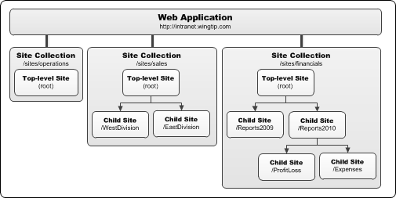
Site Collections and Sites
Sites are partitioned into Site Collections
Site collection is scope for administrative privileges
Site collection always contains top-level site
Site collection may contain hierarchy of child sites
Web application can support 1000s of site collections
Notes:
All content resides in SharePoint sites. These sites contain lists, document libraries and other subsites.
Sites are grouped into site collections. Each site collection must have exactly one site referred to as the “top-level” or “root” site. This site has all the same characteristics of other SharePoint sites.

Slide 8
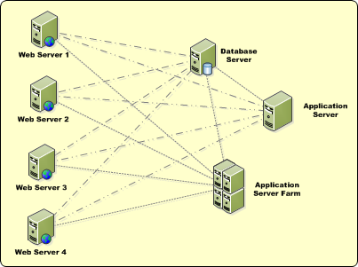
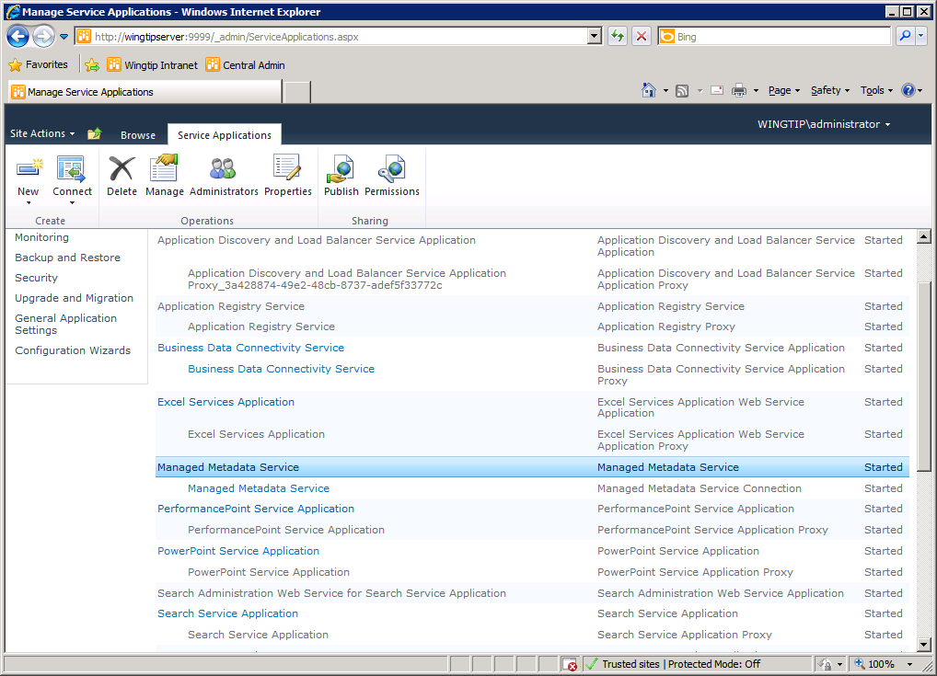
Service Applications
Services application facilitate resource sharing
This architecture is new in SharePoint Foundation
Replaces Shared Service Providers (SSPs)
Service apps can run on WFE or Application Server
Service apps can be used across farms
administrated through Central Admin
Notes:
Microsoft broke up the Shared Service Provider (SSP) framework in SharePoint 2007 into a new model called Service Applications. This new model facilitates a multitenant deployment of SharePoint 2010 as much more flexible SharePoint farm topologies.
Web applications are no longer tied to a collection of configured service offerings such as in the SSP model. Now Web applications can be associated with different service offerings (service applications) on a more a la carte model.

Slide 9
DEMO
Creating a New Site Collection using Central Administration

Slide 10
Agenda
Getting Started
The Server-side Object Model
Features and Solutions
The SharePoint Developer Tools in Visual Studio

Slide 11
The SharePoint Object Model
- Farm (SPFarm)
- Web Application (SPWebApplication)
- Site Collection (SPSite)
- Site (SPWeb)
- List (SPList)
- Item (SPListItem)
- Document Library (SPDocumentLibrary)
- File (SPFile)
- Folder (SPFolder)
Notes:
Everything you can configure in the user interface, is represented by an object in the SharePoint object model. The farm, web applications and site collections you can configure in the Central Administration, is represented by the SPFarm object, the SPWebApplication objects and the SPSite objects.
The sites are represented by SPWeb objects. Each list in the site is of type SPList and each item in the list is of type SPListItem. Some lists are document libraries and they are of type SPDocumentLibrary, which inherits from SPList. Items in a document library consists of object of type SPFile and SPFolder.

Slide 12
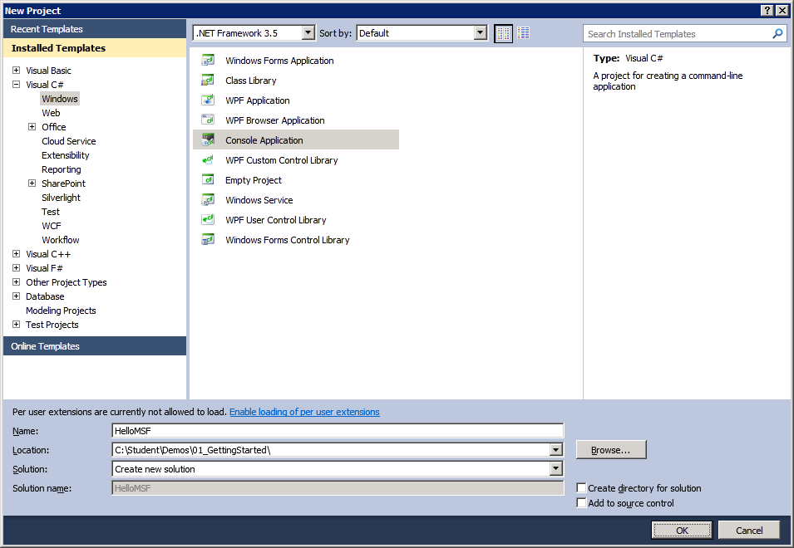
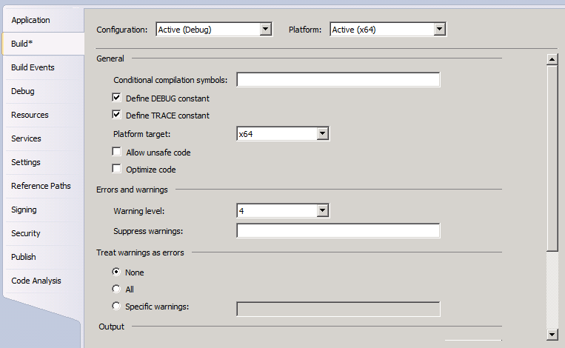
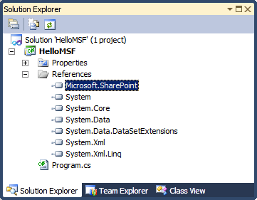
Programming with Microsoft.SharePoint.dll
Creating a Console Application
Create new application based on .NET Framework 3.5
Change project's Platform target to
x64 or AnyCPU.
Default setting of x86 causes errors!
Add reference to Microsoft.SharePoint.dll
Notes:
Using Visual Studio 2010 you can create a console application to work with the SharePoint 2010 object model. When creating the console application, you have to pay attention that the .NET Framework 3.5 is selected and not.NET Framework 4.0.
In the Project Properties you have to change the project Platform target to x64 or Any CPU.
If you want to work with the SharePoint object model, you have to add a reference to the Microsoft.SharePoint.dll which is located in the 14\ISAPI directory.

Slide 13
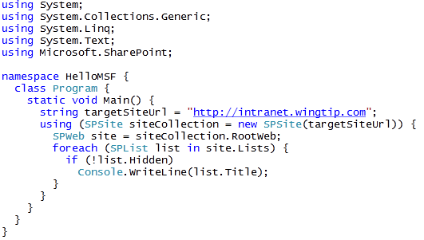
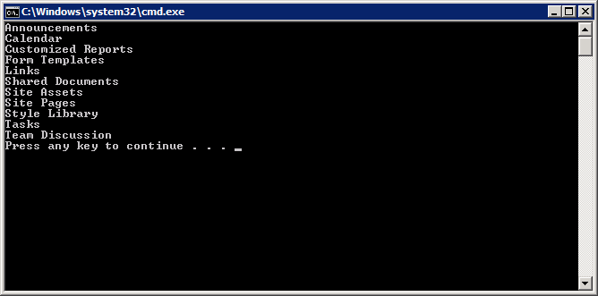
Remember This Code from WSS v3?
Notes:
After having added a reference to the Microsoft.SharePoint.dll you have access to the core part of the SharePoint object model.
You can create an SPSite object based on the URL of your SharePoint site. Use the using construct to make sure the Dispose is called to avoid memory leaks. If you don’t use the using construct, just make sure you call the Dispose method on the objects of type SPSite and SPWeb when you don’t need them anymore.
Many collections in SharePoint object model support For Each enumeration.

Slide 14
DEMO
Programming against the SharePoint Object Model

Slide 15
Agenda
Getting Started
The Server-side Object Model
Features and Solutions
The SharePoint Developer Tools in Visual Studio

Slide 16
SharePoint Solutions
SharePoint development based on solutions
Solution is a CAB file with a *.wsp extension
Solution is a container of files distributed as a unit
Solution contain manifest with instructions for installer
Solutions can be deployed two different ways
As a farm solution
As a sandboxed solution - new in SharePoint 2010
Notes:
A SharePoint solution (*.WSP) is a Microsoft cabinet file (*.CAB) that contains files to deploy to SharePoint servers. Files that can be deployed include anything that would go in the SharePointRoot folder (\[...]\14\) or assemblies that would go in a Web application’s \BIN folder or the server’s global assembly cache.
Solutions deployed to the farm (the only type of solutions deployed in SharePoint 2007) are available across the farm. A new type of solution, the “sandbox solution” allows site collection administrators to deploy custom code solutions to SharePoint.

Slide 17
The SharePointRoot Directory
SharePoint Foundation relies on set of template files
Stored in special directory known as SharePointRoot
SharePointRoot located on file system of each WFE at this path
C:\Program Files\Common Files\Microsoft Shared\Web Server Extensions\14
Farm solutions deploy their files into child directories
Path relative to SharePoint Root | Template file types
/ISAPI | Web Services (*.svc, *.ashx and *.asmx)
/Resources | Resource files (*.resx)
/TEMPLATE/ADMIN | Application pages used exclusively in Central Administration
/TEMPLATE/CONTROLTEMPLATES | ASP.NET User Controls (*.ascx)
/TEMPLATE/FEATURES | Feature definition files (*.xml)
/TEMPLATE/IMAGES | Images (*.gif, *.jpg and *.png)
/TEMPLATE/LAYOUTS | Application pages (*.aspx)
/TEMPLATE/LAYOUTS/1033/STYLES | CSS Files (*.css)
/TEMPLATE/LAYOUTS/ClientBin | Silverlight components (*.xap)
/TEMPLATE/SiteTemplates | Site Definition files (onet.xml)
/TEMPLATE/XML | Custom field type definition files (fdltype*.xml)
Notes:
The SharePoint system directory (/[…]/14/) has been given an official name in SharePoint 2010: the SharePointRoot.

Slide 18
Designing and Implementing Features
What is a SharePoint Feature?
Formally known as a “feature definition”
A unit of design and implementation
A building block for creating SharePoint solutions
Features can contain elements
e.g. menu items, links, list types and list instances
Many other element types possible
Features can contain event handlers
Implemented using a feature receiver class
Event handler code can program using SharePoint OM
Notes:
Features can be used to deploy any type of customization:
Web Parts
Application pages
Event handlers
Custom actions
Site columns
Content types
List definitions and list instances
Master pages

Slide 19
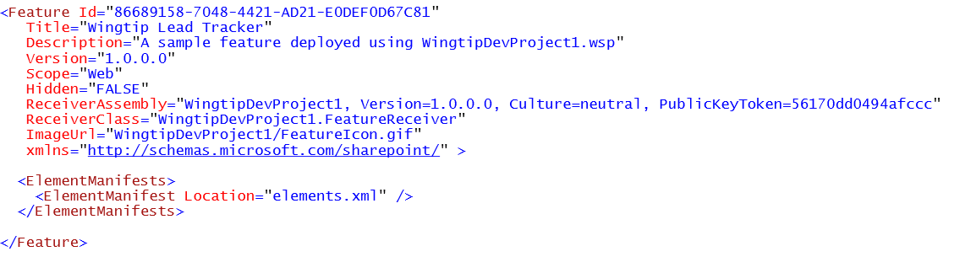
The feature.xml file
feature.xml serves as feature manifest file
Defines attributes for feature definition
Can reference one or more element manifests
Can reference a feature receiver
Notes:
The Feature definition file (feature.xml) provides metadata information to SharePoint as well as register the actions the Feature should perform when activated (element manifests) and files related to the Feature (element files).

Slide 20
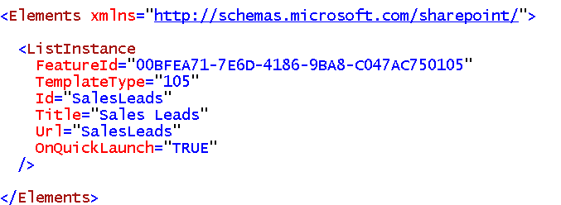
Element Manifest Files
Element manifest contain declarative elements
ListInstance elements creates list during activation
Many other element types available
element manifest can contain many elements
feature.xml file can reference many element manifests
Notes:
The element manifest files in Features is the way you will declarative do work when a Feature is activated.

Slide 21
Deployment using Solution Packages
What is a solution package?
A mechanism for best practice deployment
Atomic unit of reuse, deployment and versioning
A set of files and manifest with installation instructions
A CAB file with *.wsp extension
What can be deployed via a solution package
Feature definitions
Images
Assemblies
And much more…
Notes:
Features can be deployed to SharePoint using solution packages. A solution package is a *.cab file with extension *.wsp and contains a the files that make up the different features in the solution package.

Slide 22
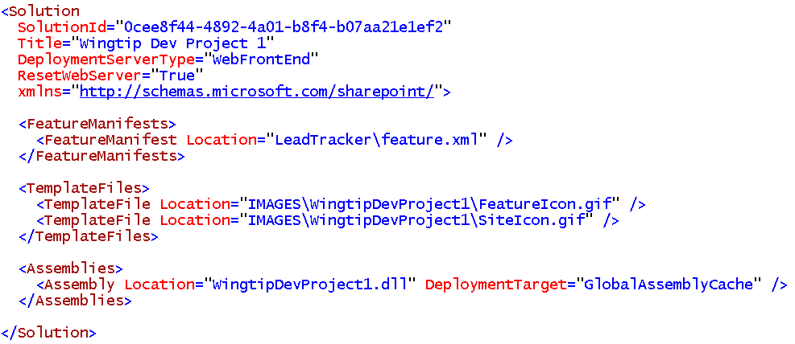
The manifest.xml file
Each Solution Package requires manifest.xml file
Mainly serves as instructions to installer on WFE
Notes:
A solution package also contains a manifest.xml. This file defines the list of features, site definitions, resource files, Web Part files, and assemblies to process.

Slide 23
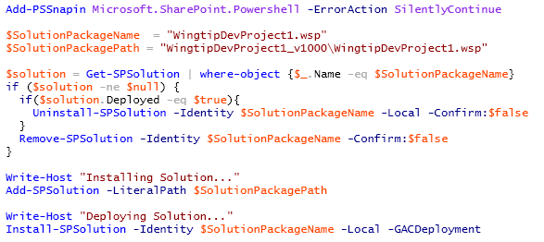
Farm Solution Deployment
Done using Windows PowerShell scripts
Call Add-SPSolution to install solution package Copies *.wsp file to the configuration database
Call Install-SPSolution to deploy solution package Pushes *.wsp file to each WFE and runs installer
Notes:
The script in the screenshot on this slide demonstrates adding & deploying a farm solution to the farm. However before deploying the solution it first checks to see if the solution is already present and/or deployed. If so, it retracts (uninstalls) the solution and then removes it from the solution store.
The process of adding/updating/removing a sandbox solution is very different as it will be uploaded to a special gallery the same way documents are uploaded to document libraries.

Slide 24
Agenda
Getting Started
The Server-side Object Model
Features and Solutions
The SharePoint Developer Tools in Visual Studio

Slide 25
SharePoint Developer Tools in Visual Studio 2010
SharePoint Developer Tools
Provide an end-to-end developer story for SharePoint 2010
Extend the VS project system for SharePoint Projects
Provides project item templates for SharePoint objects
Automatically builds solution package for SharePoint Project
Extensible by 3rd party developers
Caveat: works with SharePoint 2010 not SharePoint 2007
Benefits to SharePoint developers
Abstracts away details of SharePointRoot directory
Abstracts away details of building *.wsp file
Lessens / eliminates need for external utilities
Notes:
The Visual Studio 2010 SharePoint Tools (SPT) represents a significant step forward for professional developers using SharePoint.
SharePoint Explorer follows quick exploration through a site. This makes it possible to launch browser at specific place within site.
SharePoint 2010 introduces a new project structure as well as project templates and project item templates. There are designers to create things like features and solution packages.
One of the most appealing aspects of SPT is that it is extensible
You can add your own custom project templates and item templates.
You can add menu commands into the Visual Studio UI.

Slide 26
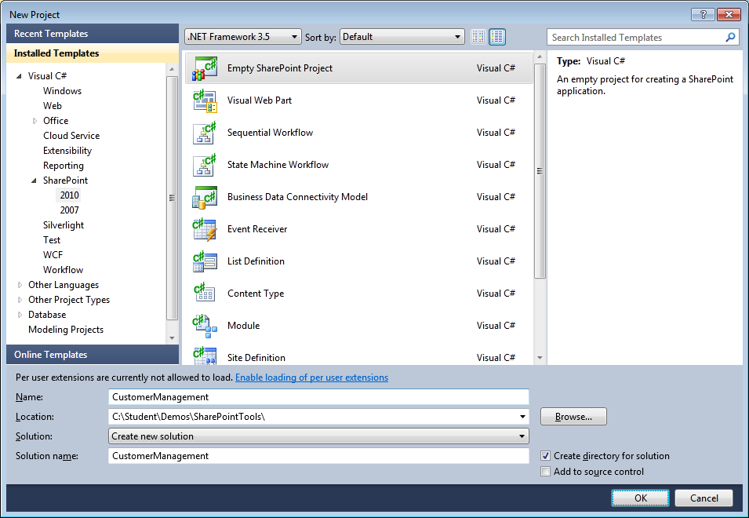
SharePoint 2010 Project Templates
SharePoint Tools provide several project templates
All project templates generate "SharePoint project"
SharePoint projects have extended set of properties and behaviors
Notes:
The SharePoint Tools in Visual Studio 2010 provide several project templates depending of which type of SharePoint artifact you want to develop. There are project templates for web parts, application pages, list definitions, content types, workflows, etc.

Slide 27

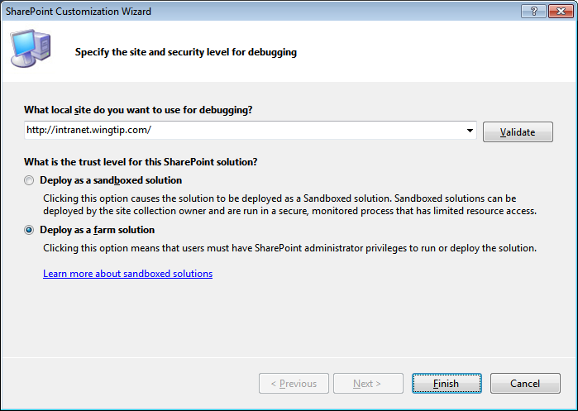
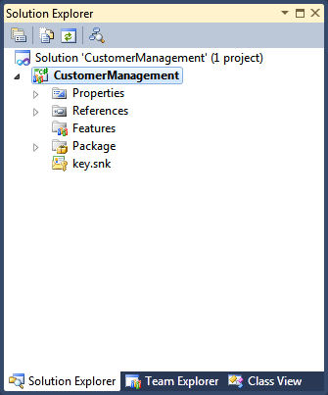
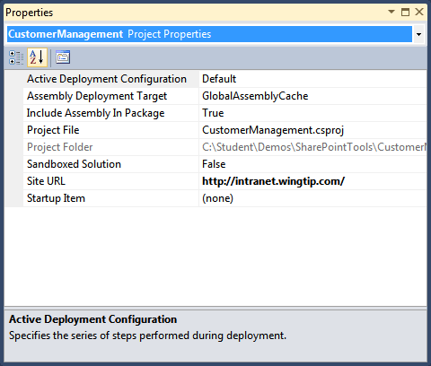
SharePoint 2010 Project Properties
SharePoint Projects properties
Project File
Project Folder
Active Deployment Configuration
Include Assembly in Package
Assembly Deployment Target
Sandboxed Solution
Site URL
Startup Item
Notes:
When you create a SharePoint project based on one of the SharePoint project templates, you are guided through a wizard where you have to enter a valid SharePoint URL and set some other properties based on the selected project template. These values are reflected in the project Properties window.

Slide 28
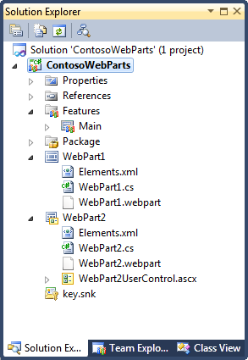
SharePoint 2010 Project Structure
Standard Project Nodes
Properties (standard with all Visual Studio projects)
References (standard with all Visual Studio projects)
Features (added by SharePoint Tools)
Package (added by SharePoint Tools)
SharePoint Project Items (added using SharePoint Tools Project Item Templates)
Notes:
When the project is created, the project has a typical structure. The Properties and References nodes are standard for all Visual Studio projects, but you will also have nodes like Package and Features. Depending on the type of SharePoint project you are creating, you will have some additional nodes reflecting the SharePoint project items you are creating.

Slide 29
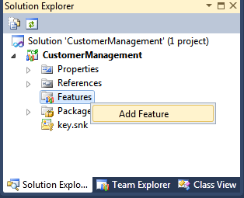
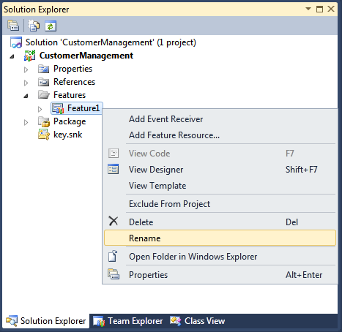
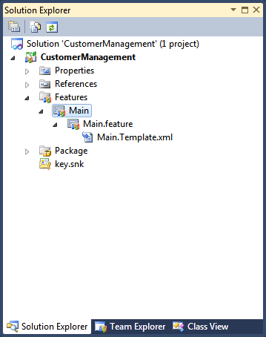
Adding a New Feature
Right-click Features node and select Add Feature
Right-click new feature node and select Rename
Notes:
You can add additional features to a SharePoint project by right-clicking the Features node and selecting Add Feature. Features have names like Feature1, Feature2,... You can best rename them to a meaning full name.

Slide 30
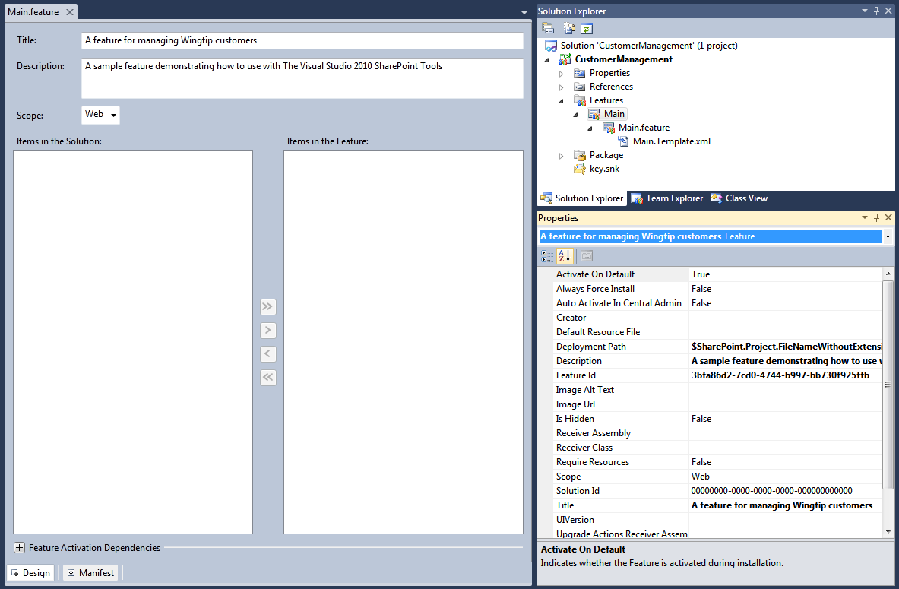
Feature Designer and Property Sheet
Each Feature has designer and property sheet
Feature designer provides design mode and XML text mode
Customize feature properties in designer and / or property grid
Feature designer allows adding / removing SPIs
Notes:
The Visual Studio Tools for SharePoint also come with a nice Feature Designer where you can change some properties like the title of the feature and its scope.
Each feature also has a property sheet where you can also modify properties.
If you need to make additional changes to the feature definition, you can edit the feature manifest by clicking the [+] button next to Edit Options and type in your changes.

Slide 31
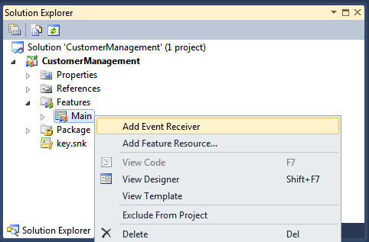
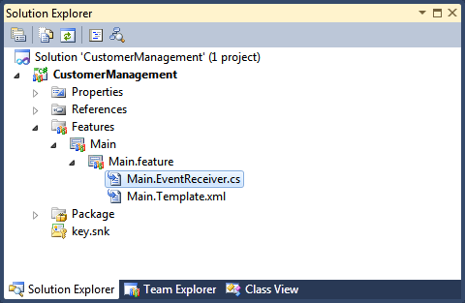
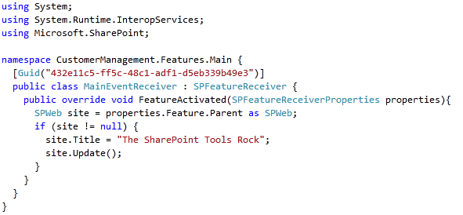
Creating a Feature Receiver
Notes:
If you need to perform actions while the feature gets activated in SharePoint, you can add a feature receiver by right-clicking the feature in the Features node and choosing Add Event Receiver. This will add a class to your project that inherits from SPFeatureReceiver. You can add code to events like FeatureActivated and FeatureDeactivated.

Slide 32
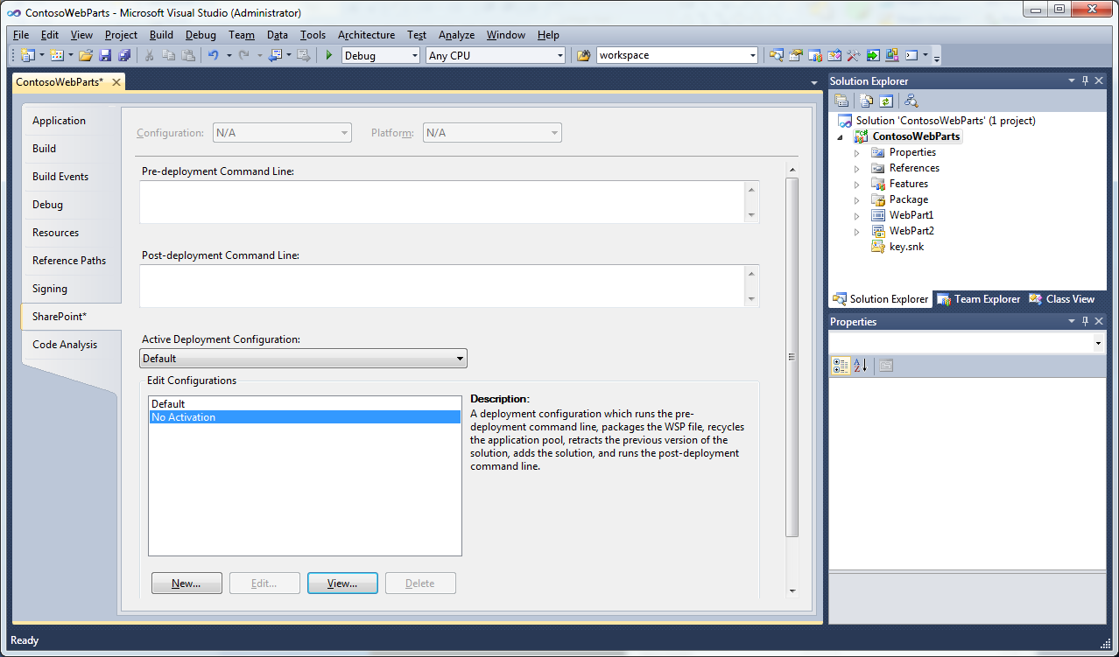
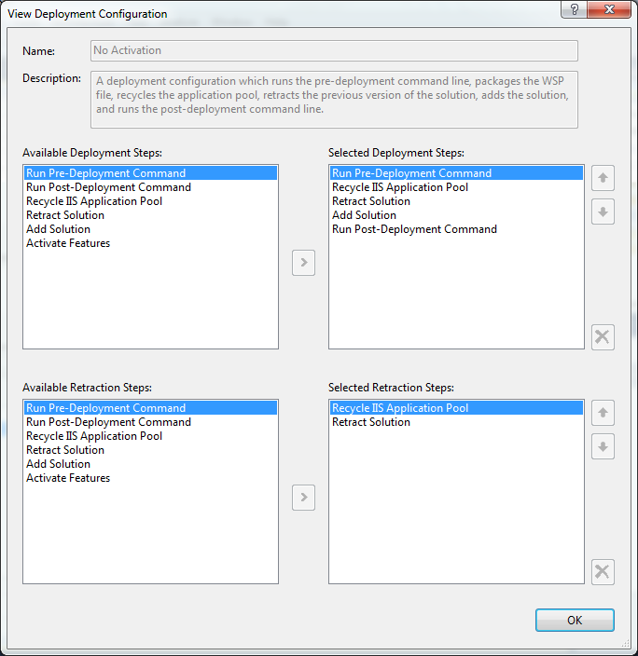
Deployment Configurations
Project contains set of deployment configurations
Projects created with Default and No Activation
You can create additional deployment configurations
SharePoint Tools extensions can add custom steps
Notes:
When it comes to deploying your SharePoint project, you can choose between different deployment configurations.
Right-click your project in the Solution Explorer and choose Properties. In the Properties window select the SharePoint tab. There are two standard deployment configurations: Default and No Activation. If needed, you can create your own deployment configuration. Clicking the New button opens a dialog where you can choose from a set of existing deployment steps.
Using Visual Studio 2010 SharePoint Tools extensions, you can add your own custom steps.

Slide 33
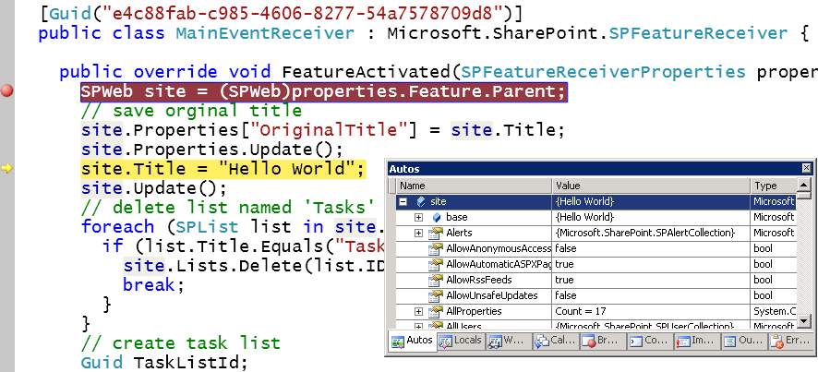
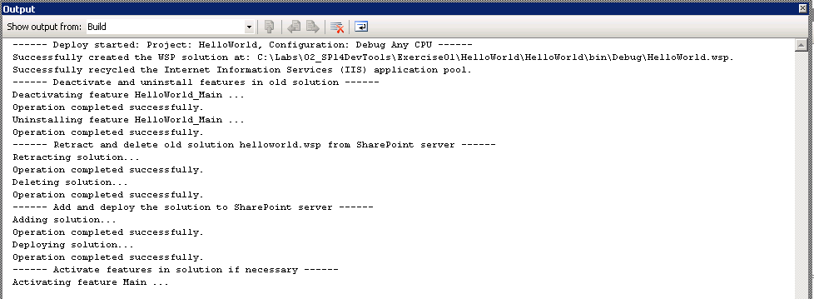
The F5 Debugging Experience
What does F5 do?
Builds new version of *.wsp file
Deactivates / uninstalls feature
Retracts / deletes old *.wsp file
Adds / deploys new *.wsp file
Activates feature in target site (via Site Url)
Attaches debugger to W3WP.EXE worker process (via Site URL)
Notes:
You can right-click the project in Solution Explorerand choose Deploy to deploy your SharePoint project. But you can also press [F5].
Pressing [F5] builds the *.wsp, deactivates/uninstalls the features if they were previously deployed, retracts/deletes the old *.wsp, adds/deploys the freshly build *.wsp, and activates the features in the target site. It also attaches the debugger to the W3WP.exe worker process, which is the SharePoint worker process and lets you debug your SharePoint code.

Slide 34
DEMO
Creating and Debugging a SharePoint Project

Slide 35
Agenda
Getting Started
The Server-side Object Model
Features and Solutions
The SharePoint Developer Tools in Visual Studio

